Slide 1

NLP-Based Analysis of Prednisolone Adverse Reactions
Analysis of Adverse Reactions of Prednisolone in the Treatment of Nephrotic Syndrome

Slide 2

Introduction
Pharmacovigilance ensures drug safety by identifying adverse reactions.
Prednisolone is widely used, but ADRs require systematic investigation.
The FDA FAERS database provides real-world adverse event data.
NLP and machine learning techniques enable automated ADR analysis.

Slide 3
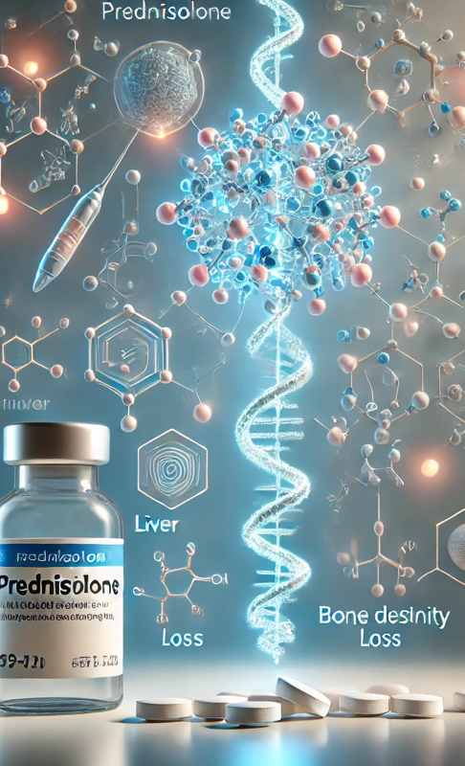
Research Objectives
1. Extract and analyze Prednisolone-related ADRs from FAERS.
2. Identify key patterns and emerging ADR signals.
3. Compare known ADRs with new potential safety concerns.
4. Summarize frequently reported ADRs.
5. Detect anomalies and rare ADR signals.

Slide 4
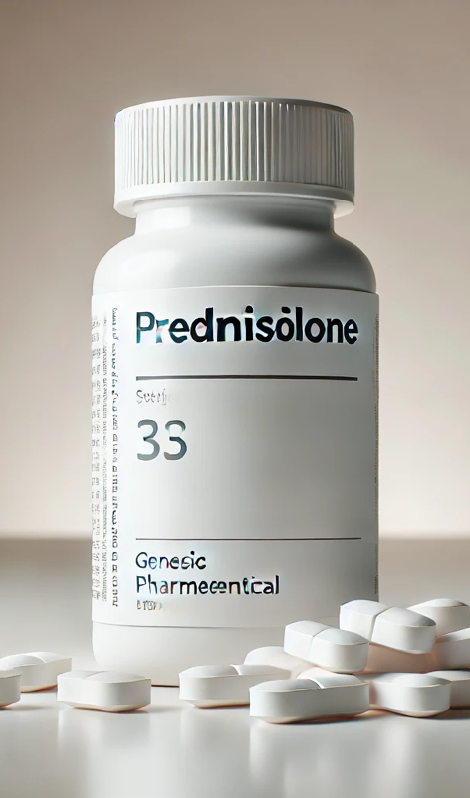
Literature Review
BERT for NLP-based Drug Safety Monitoring.
Data Mining in Pharmacovigilance (PRR, ROR, BCPNN).
FAERS Data Analysis for Real-World ADR Identification.
Clustering for Longitudinal Treatment Pattern Analysis.
Information Extraction from FDA Drug Labeling.

Slide 5
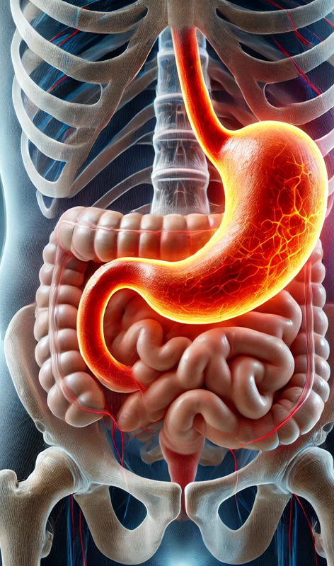
Methodology
Data Collection from FAERS (2005–2024).
NLP-Based Information Extraction (NER, Text Summarization, Sentiment Analysis).
Text Mining & Pattern Recognition (Topic Modeling, Clustering, Anomaly Detection).
Statistical Analysis (PRR, ROR) and Visualization.
Model Validation & Interpretation.

Slide 6

Expected Outcomes
Comprehensive list of Prednisolone ADRs (ranked by frequency and severity).
Identification of emerging ADR signals.
NLP-based ADR classification model.
Interactive visualization dashboards for monitoring.

Slide 7
Challenges & Mitigation Strategies
Challenge | Mitigation Strategy
Data inconsistencies | Standardized preprocessing pipeline
NLP model bias | Fine-tune with medical datasets
Rare ADR detection | Anomaly detection algorithms
Computational complexity | Cloud-based infrastructure

Slide 8
Research Timeline
Phase 1: Data Extraction & Preprocessing (1 month)
Phase 2: NLP Model Development (1 months)
Phase 3: ADR Analysis & Statistical Modeling (1 months)
Phase 4: Validation & Interpretation (1 month)
Phase 5: Report & Visualization (1 month)
Total Duration: 5 months

Slide 9
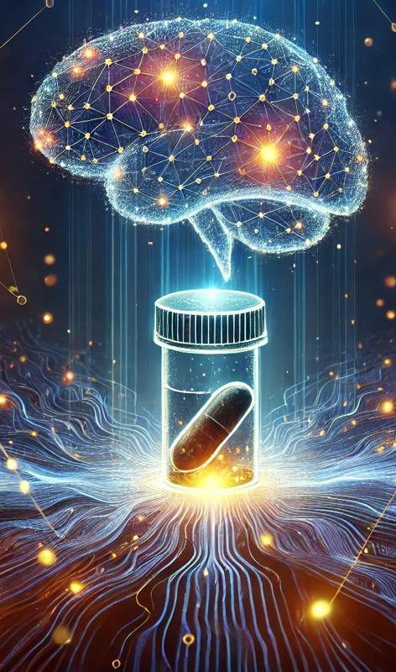
Conclusion
NLP and machine learning enable automated ADR analysis.
FAERS data provides valuable insights into Prednisolone safety.
Study findings can enhance drug safety monitoring and regulatory decisions.
Next Steps: Model implementation and real-time validation.

